Slide 1

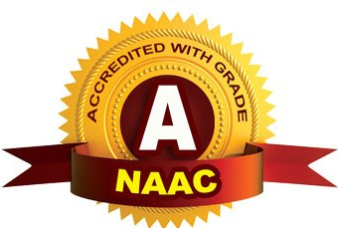
CMR TECHNICAL CAMPUS
(UGC AUTONOMOUS)
Accredited by NBA & NAAC with ‘A’ Grade
Approved by AICTE, New Delhi and JNTU, Hyderabad
Kandlakoya, Medchal Road, Hyderabad- 501 401, Telangana
ESTD: 2009
Department of CSE
Organ Donation and Transplantation Using Blockchain
Batch no.11
Project Coordinator:
Dr J. Narasimha Rao
Associate Professor, CSE Department
Project Guide:
G. Lavanya
(Assistant Professor,CSE Department)
Presented By:
G. Sruthi (217R1A05M8)
E. Pavani (217R1A05M5)
T. Nagalaxmi (217R1A05R0)

Slide 2
Contents
Abstract
Existing System
Disadvantages
Proposed System
Advantages of Proposed System
Hardware and Software Requirements
Novelty of project
Module
Diagrams
Output
Conclusion

Slide 3
Abstract
Blockchain technology can enhance organ donation and transplantation by making the process more efficient and secure. Every step, from registering donors to matching organs and follow-up care, can be accurately tracked on a blockchain. This reduces fraud and ensures all stakeholders have access to real-time information. Blockchain is facilitated through smart contracts, which are crafted using Solidity programming. Furthermore, Blockchain's decentralized nature means that data is stored across multiple servers or nodes.
Overall, blockchain offers a valuable solution to improve the organ donation process and build trust in the system.

Slide 4
Existing System
Current organ donation and transplantation systems use central databases, matching tools, and rules, but they have many issues. Databases, like those managed by United Network for Organ Sharing (UNOS), help track donors and recipients but can be hacked or have problems.
Matching tools are meant to assign organs based on who needs them most, but they can be unclear, unfair, and slow. Organ Procurement Organizations (OPOs) help recover and distribute organs, but they struggle with communication and have limited resources. The rules are there to ensure fairness, but they can be complicated and slow down the process.
These issues show the need for a better, clearer, and safer system, making blockchain a good option to improve organ donation and transplantation.

Slide 5
Disadvantages of Existing System
Centralized systems can be hacked, risking sensitive donor and recipient information.
The complex algorithms are hard to understand, which can erode trust in the system.
Algorithms may reflect past biases.
These algorithms can be slow
OPOs have to manage many different stakeholders.
Resource Limitations in OPOs
Risking sensitive patient information.
Different EHR systems may not work well together

Slide 6
Proposed System
It aims to solve the problems of current methods by using decentralized technology. This system has a blockchain ledger that securely records every transaction. The ledger is unchangeable and transparent, allowing authorized users to access information in real-time. Smart contracts automate processes like matching donors with recipients. Enhanced security measures, such as cryptographic encryption and controlled access.
Below are six key types of algorithms and techniques that are typically used:
Consensus Algorithms: Ensure the blockchain is decentralized and secure.
Smart Contracts: Automate the organ matching and allocation process.
Zero-Knowledge Proofs: Provide data privacy while maintaining transparency.
Homomorphic Encryption: Allow encrypted data to be used for matching.
Distributed Hash Tables: Efficiently store and access decentralized organ and patient data.
Matching Algorithms (e.g., ML): Improve organ donor-recipient matching with transparency and immutability.

Slide 7
Advantages
Enhanced Transparency and Traceability
Improved Security
Reduced Administrative Costs and Errors
Enhanced Donor and Recipient Confidence
High Accuracy

Slide 8
Hardware and Software Requirements
Hardware Requirements:
Processor - Pentium –IV
RAM - 4 GB (min)
Hard Disk - 20 GB
Key Board - Standard Windows Keyboard
Mouse - Two or Three Button Mouse
Monitor - SVGA
Software Requirements:
Operating System - Windows XP
Coding Language - python

Slide 9
Novelty of project
Blockchain keeps a permanent record, making sure donor and recipient information is safe and easy to check.
People can control who sees their health information, protecting their privacy.
A worldwide database can help find organs for patients in different countries, saving more lives.
The clear records on blockchain make it harder for illegal activities, like organ trafficking, to happen.
Blockchain allows for tracking organs as they move from donor to recipient, ensuring safe delivery.

Slide 10
Module
Donors Module
Register and Login
Upload Data
View Profile
Send Organ Details
View Donation Status
Patients Module
Login
View Profile
Register for Transplant
View Transplant Details

Slide 11
Hospital Module
Manage Records: Hospitals keep track of organ storage and donation records.
View Patients: They can see all patients and approve their requests.
View Donors: Hospitals can see all donors and approve their information.
Add Organ Types: They can add different types of organs available for donation.
View Blockchain Codes: Hospitals can see the blockchain codes for all organ names.
View Donation Details: They can see details about all donated organs.
View Transplant Requests: Hospitals can check all requests for organ transplants.
View Results: They can view results for both organ donations and transplants.

Slide 12
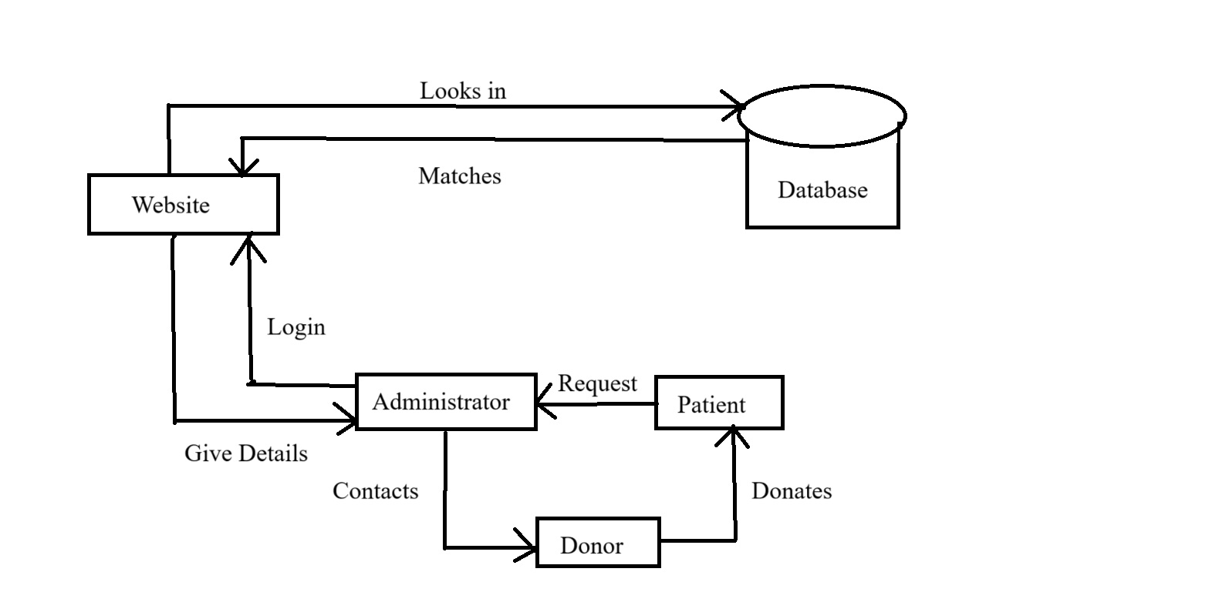
Architecture Diagram

Slide 13
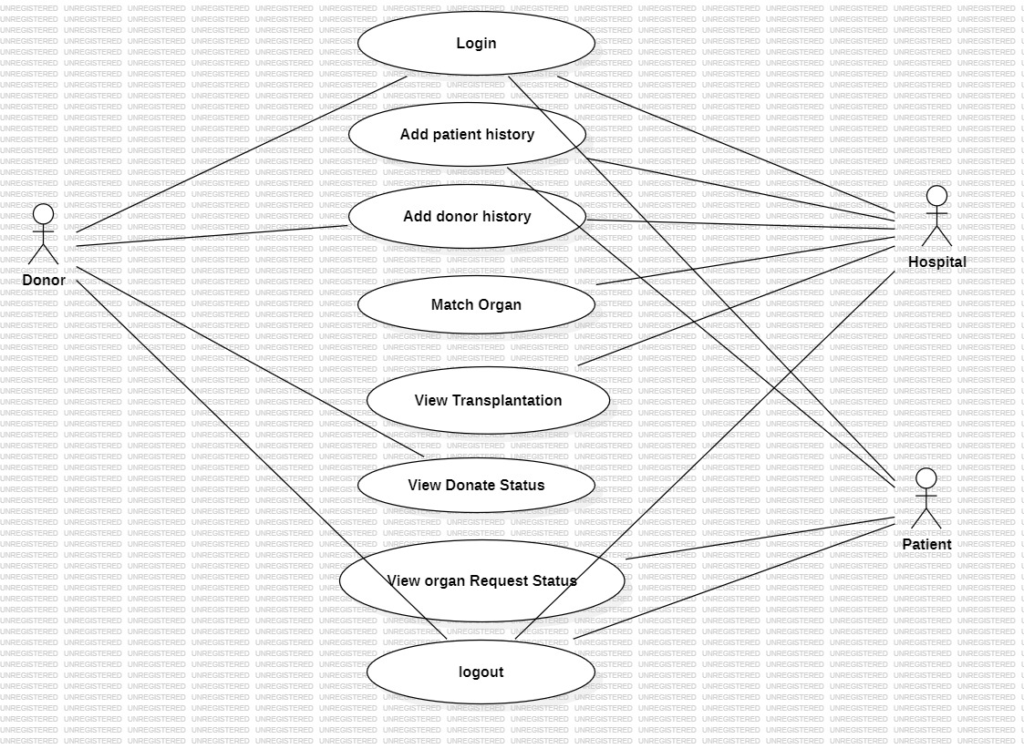
Usecase Diagram

Slide 14
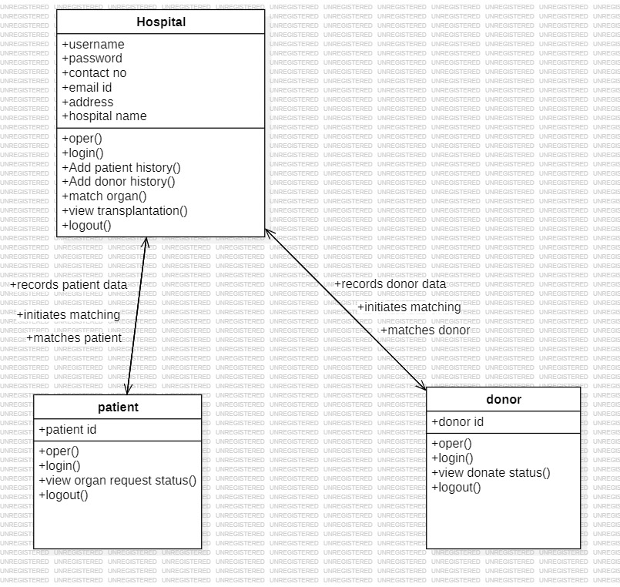
Class Diagram

Slide 15
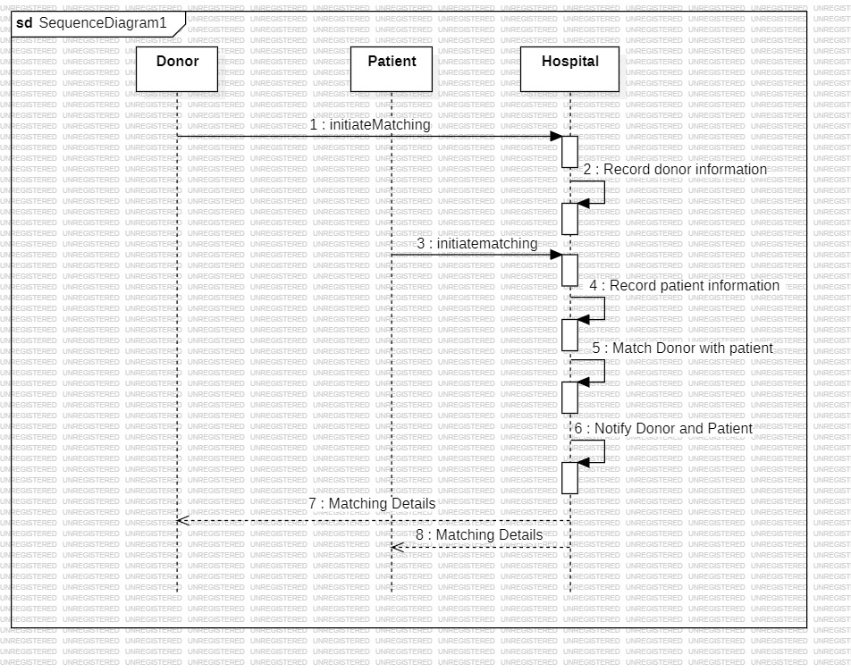
Sequence Diagram
Login/Register
Login/Register

Slide 16
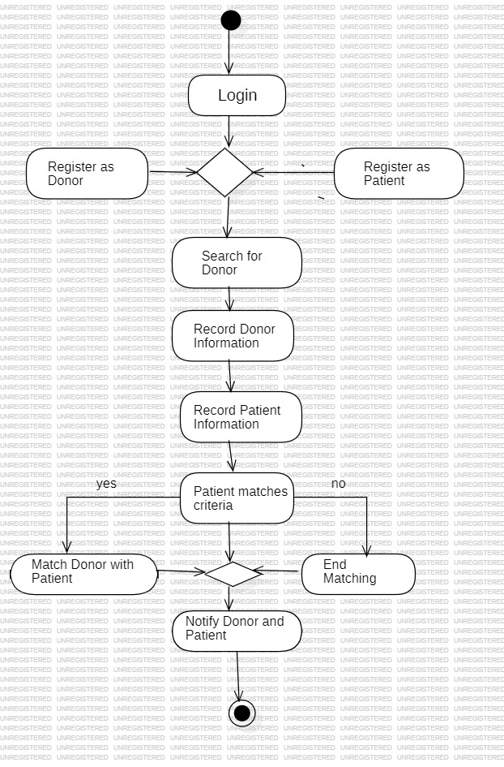
Activity Diagram

Slide 17
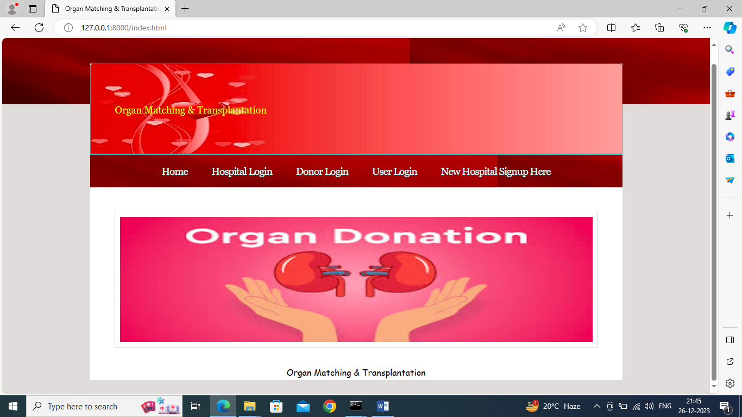
OUTPUT

Slide 18
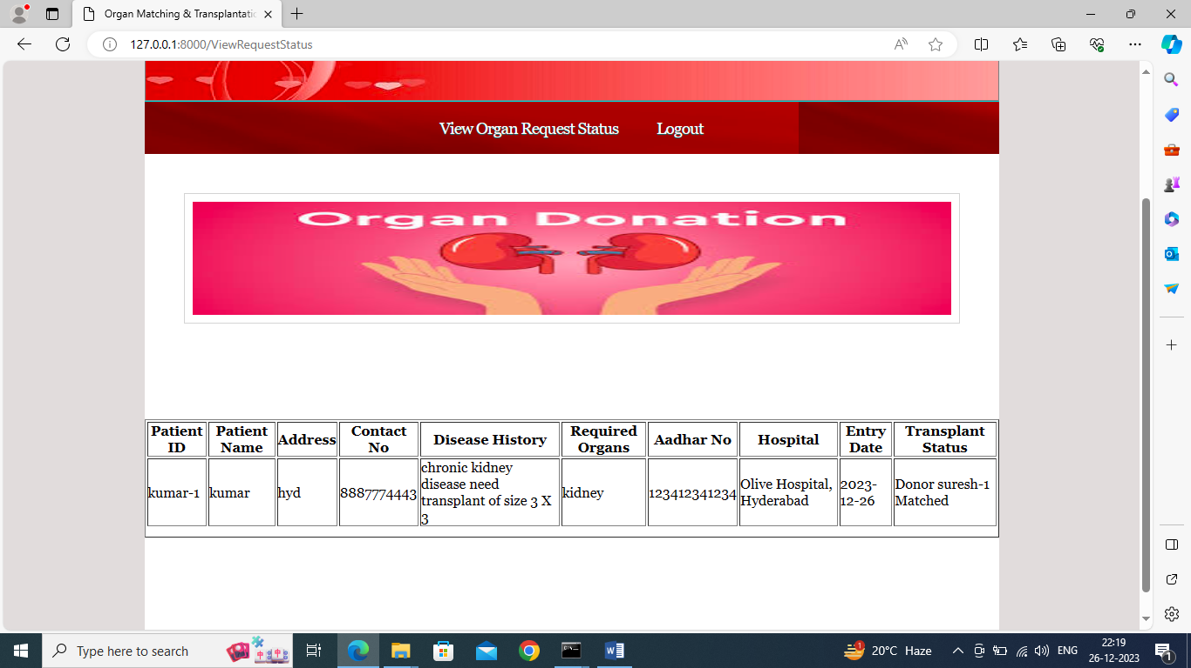

Slide 19
SAMPLE CODE
{
"contractName": "Organ",
"abi": [
{
"inputs": [],
"stateMutability": "nonpayable",
"type": "constructor"
},
{
"inputs": [],
"name": "donor_history",
"outputs": [
{
"internalType": "string",
"name": "",
"type": "string"
}

Slide 20
],
"stateMutability": "view",
"type": "function",
"constant": true
},
{
"inputs": [],
"name": "patient_history",
"outputs": [
{
"internalType": "string",
"name": "",
"type": "string"
}
],
"stateMutability": "view",
"type": "function",
"constant": true
},

Slide 21
{
"inputs": [],
"name": "users",
"outputs": [
{
"internalType": "string",
"name": "",
"type": "string"
}
],
"stateMutability": "view",
"type": "function",
"constant": true
},
{
"inputs": [
{
"internalType": "string",
"name": "us",
"type": "string"
}

Slide 22
],
"name": "addUser",
"outputs": [],
"stateMutability": "nonpayable",
"type": "function"
},
{
"inputs": [],
"name": "getUser",
"outputs": [
{
"internalType": "string",
"name": "",
"type": "string"
}
],
"stateMutability": "view",
"type": "function",
"constant": true
},

Slide 23
conclusion
In conclusion, the proposed blockchain system changes how we manage organ donation and transplantation.
It solves major problems in current systems. The new system offers better transparency, security, efficiency
and patient outcome.
It is not only benefited for the patient how need organs, it is also helpful for the healthcare providers and the
entire healthcare system

Slide 24
Future Scope
Improved Traceability and Accountability
Faster Matching and Allocation
Data Security and Privacy
Reduction in Organ Trafficking
Long-Term Monitoring of Transplanted Organs
Public Confidence and Trust in the System

Slide 25
References
Miller, A. R., & Tschantz, M. (2020). "Blockchain Technology in Healthcare: A Comprehensive Review and Directions for Future Research." Journal of Healthcare Informatics Research, 4(3), 263-296.
This paper provides an extensive review of blockchain technology applications in healthcare, including its potential benefits and challenges.
Tian, F. (2016). "An Agri-food Supply Chain Traceability System for Blockchain-based Trusted Computing." Proceedings of the 2016 13th International Conference on Service Systems and Service Management.
Although focused on the agri-food industry, this paper discusses blockchain-based traceability systems that can be applicable to healthcare data management.
Kshetri, N. (2017). "Blockchain's Roles in Meeting Key Supply Chain Management Objectives." International Journal of Information Management, 39, 80-89.
This article explores blockchain’s capabilities in supply chain management, which can be extrapolated to organ donation and transplantation systems.
GitHub Link
https://github.com/Pavani114/organdonation

Slide 26
Thank You

